Slide 1
Riparian zones enhancement project
A guide to native, salt tolerant plant species available at Cornhill Nursery

Slide 2
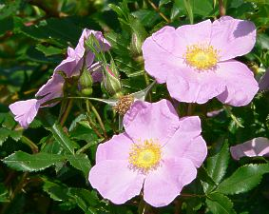
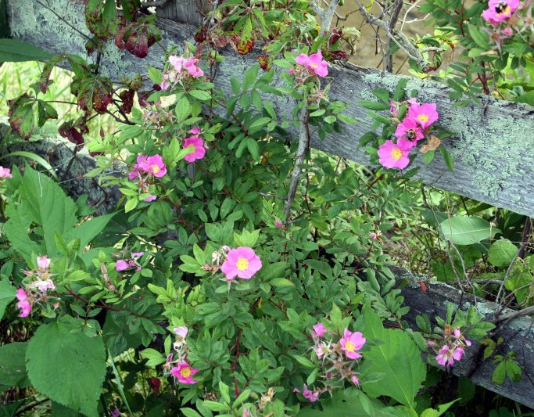
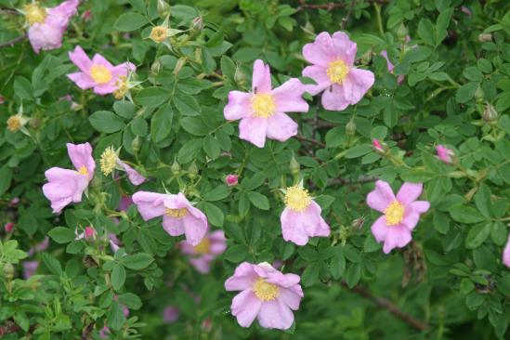
Roses
Rosa carolina
Max. height: 2-3m
Rosa virginiana
Max. height: 1.25m

Slide 3
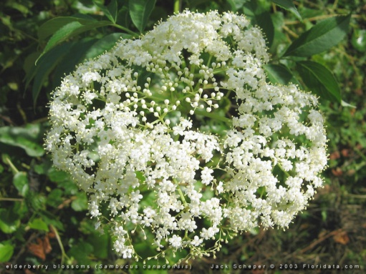
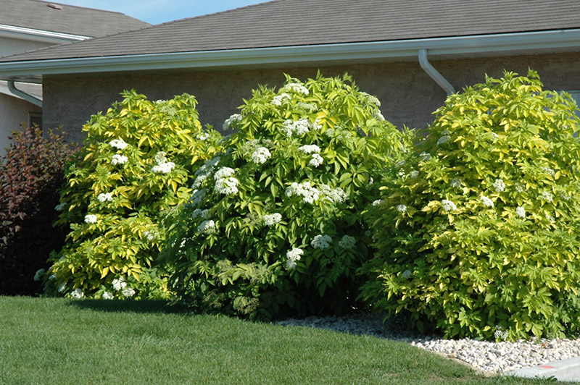
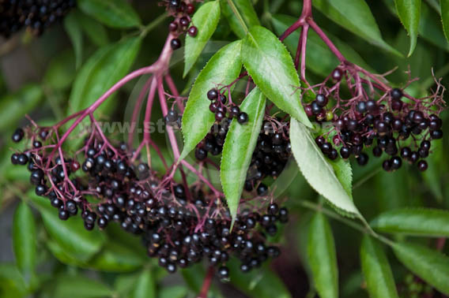
Fruiting shrubs
Elderberry (Sambucus canadensis)
Max.height: 3-4m
Flowers
Fruits

Slide 4
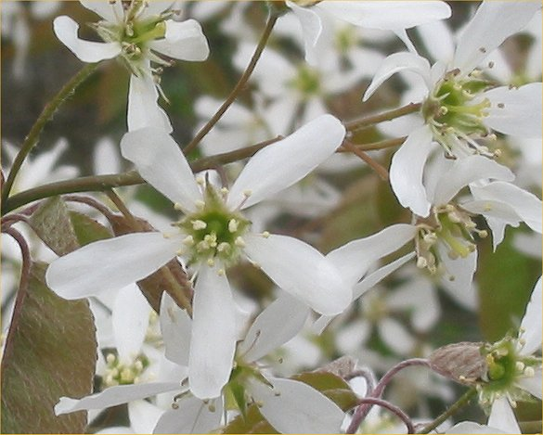
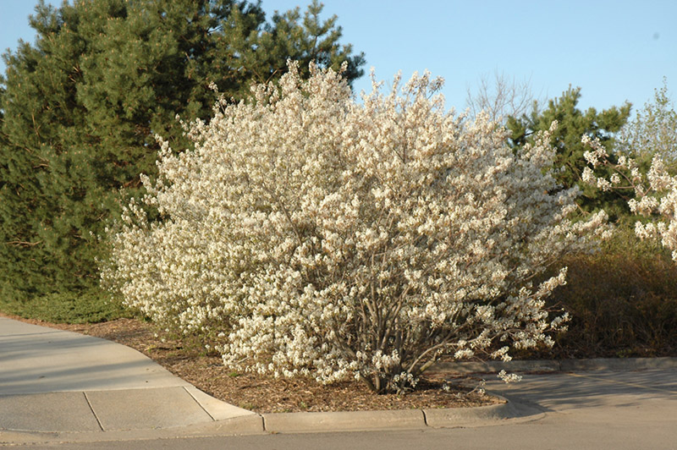
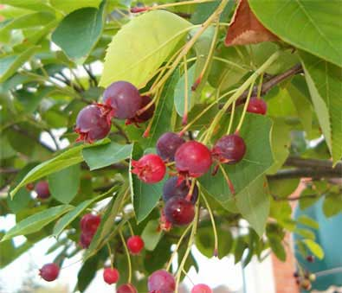
Fruiting shrubs
Serviceberry (Amelanchier canadensis)
Height: 2-8m
Shade tolerant
Flowers
Fruits

Slide 5
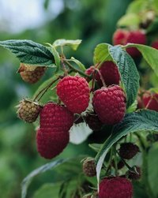
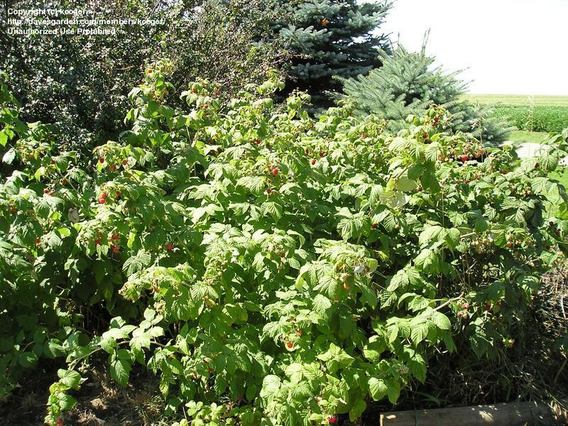
Fruiting shrubs
Red raspberries (Rubus idaeus)
Max height: 2m
‘Nova’ variety

Slide 6
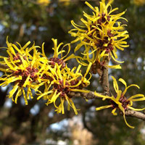
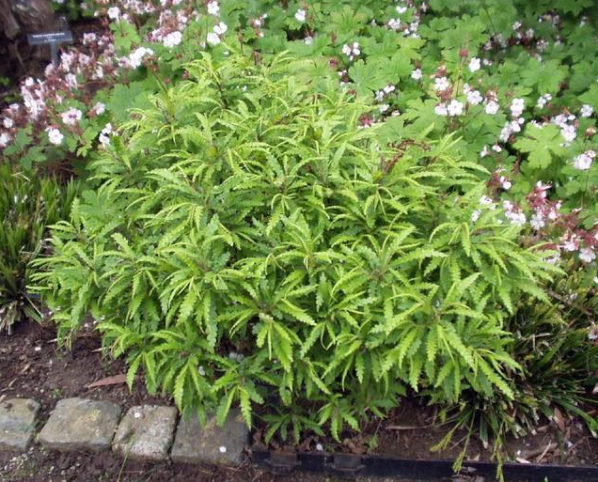
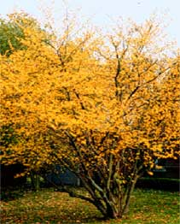
Shrubs
Sweet fern (Comptonia peregrina)
Max. height: 1m
Witch Hazel (Hamamelis virginiana)
Max. height: 3m
Shade tolerant

Slide 7
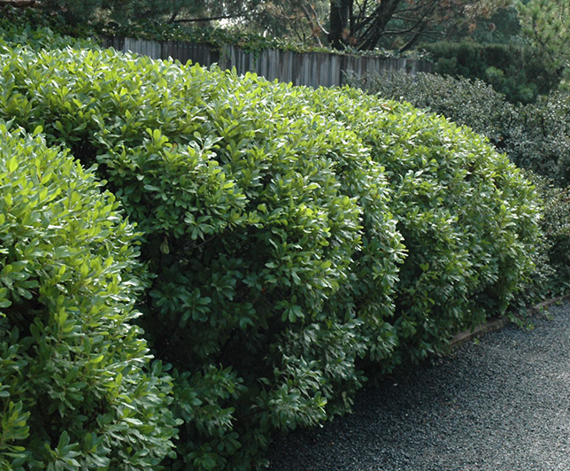
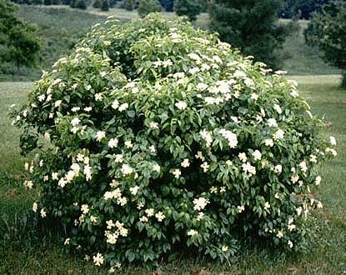
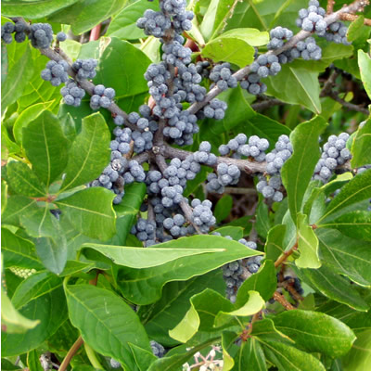
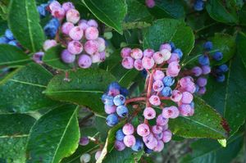
Shrubs
Bayberry (Myrica pennsylvanica)
Max height: 2m
Wild Raisin (Viburnum cassinoides)
Max. height: 3m
Shade tolerant
Fruits
Fruits

Slide 8
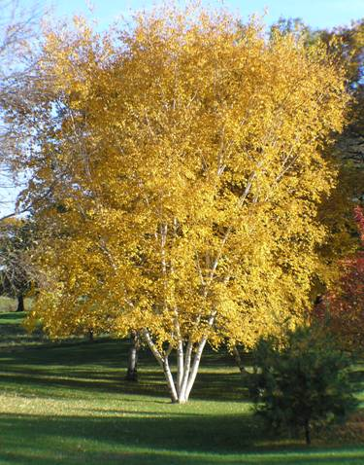
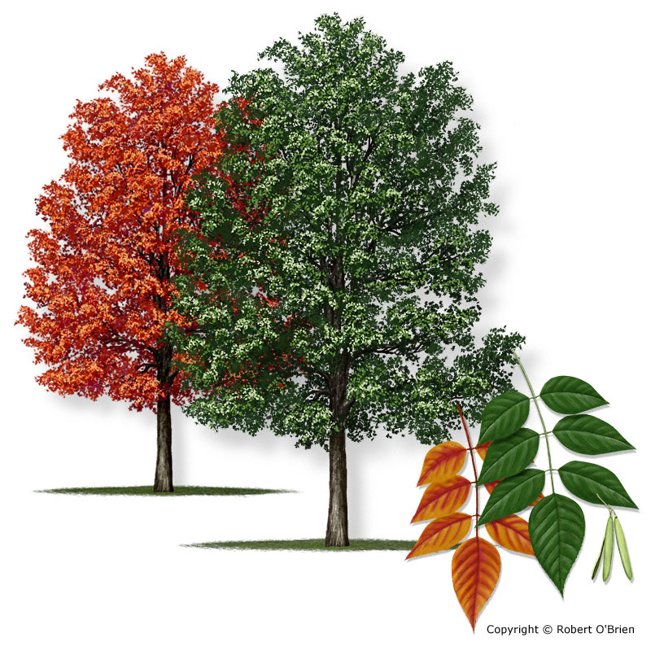
Deciduous trees
Paper birch (Betula papyfera)
Max. height: 15m
White ash (Fraxinus americana)
Max. height: 25m

Slide 9
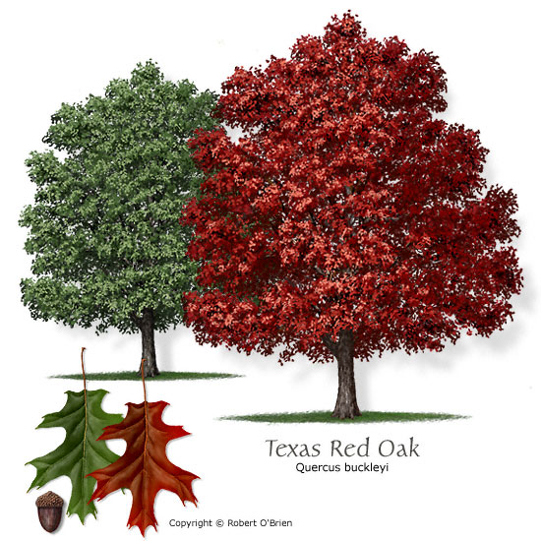
Deciduous trees
Red oak (Quercus rubra)
Max. height: 30m

Slide 10
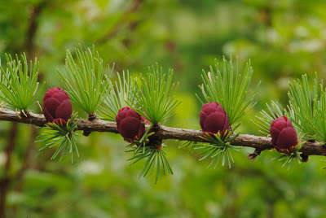
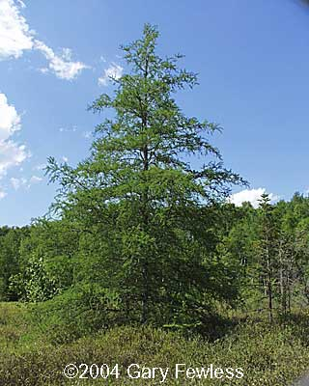
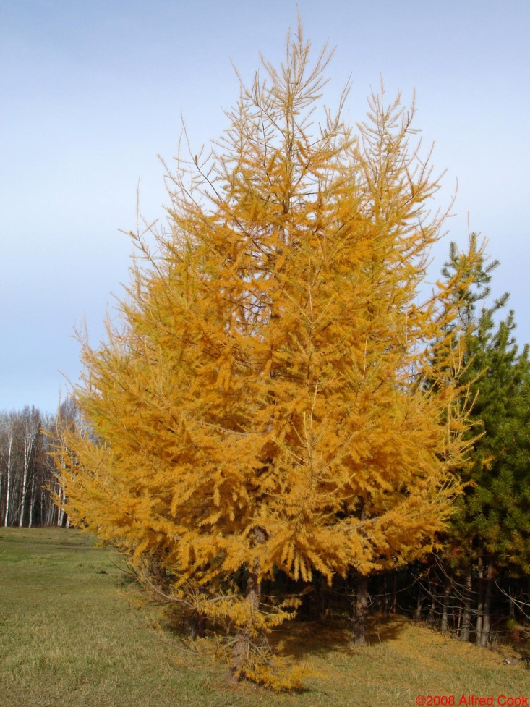
Evergreens
Tamarack (Larix laricina)
Max. height: 20m

Slide 11
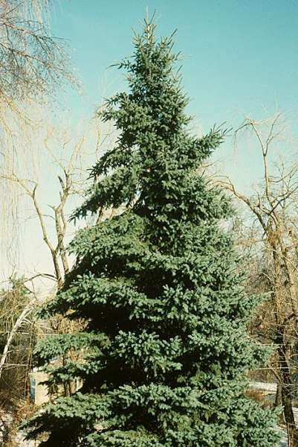
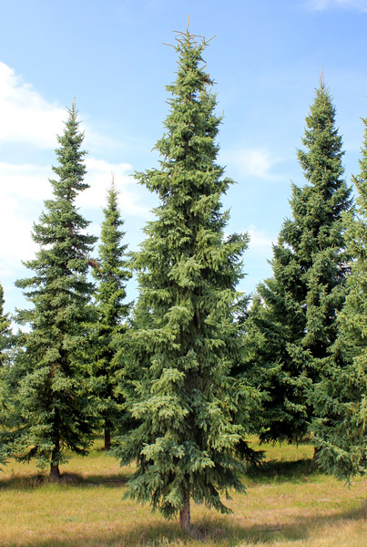
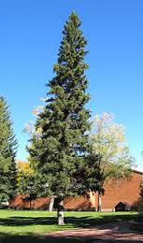
Evergreens
White spruce (Picea glauca)
Max. height: 20m
Black spruce (Picea mariana)
Max. height: 20m
Red spruce (Picea glauca)
Height: 20m

Slide 12
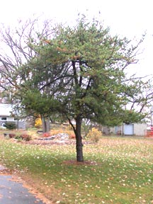
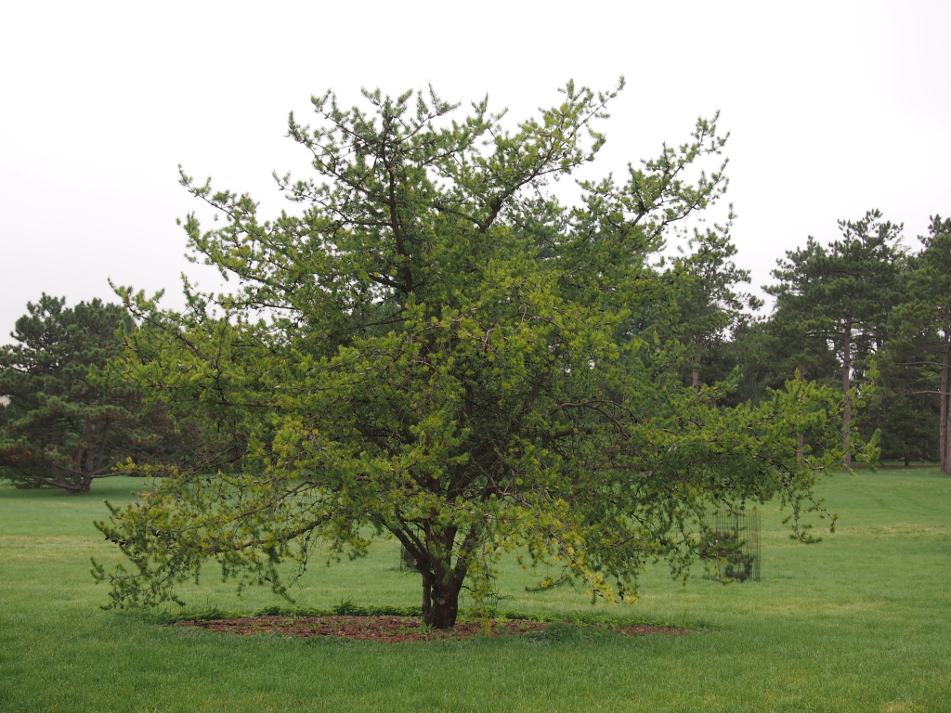
Evergreens
Jack pine (Pinus banksiana)
Max. height: 22m

Slide 13
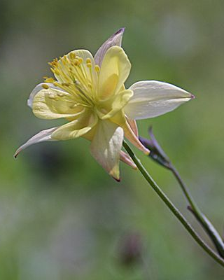
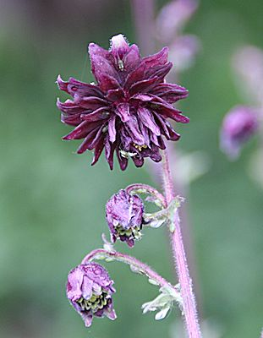
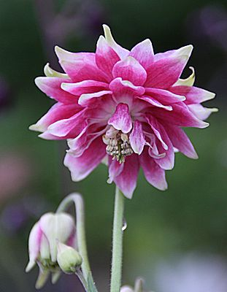
Perennials
Columbine (Aquilegia spp.)
Max. height: 1m
Ruby Port variety
Nora Barlow variety

Slide 14
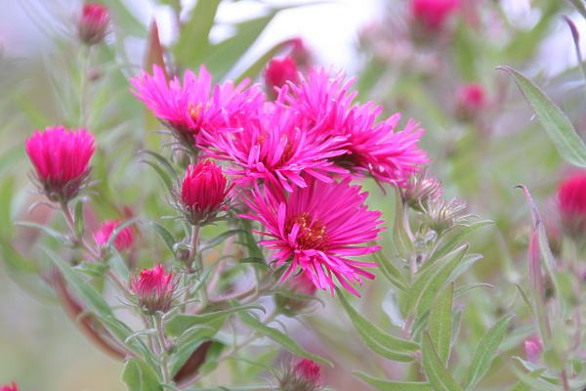
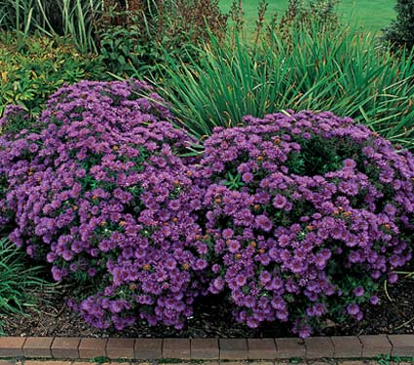
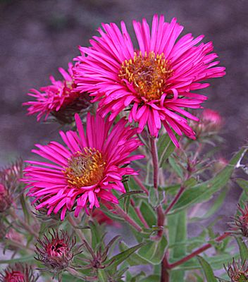
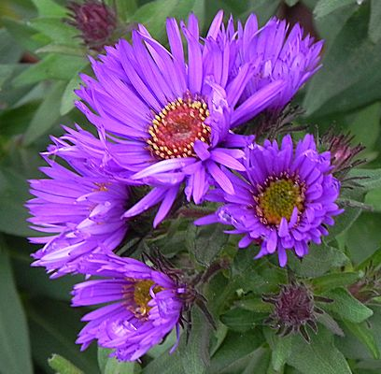
Perennials
Aster spp.
Max height: 1m
Purple dome variety
Lambada variety

Slide 15
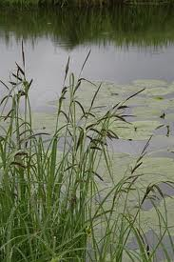
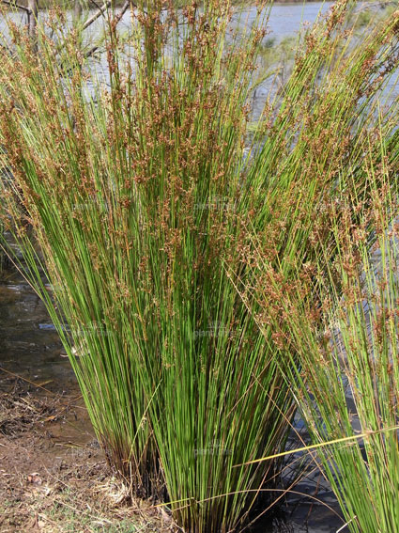
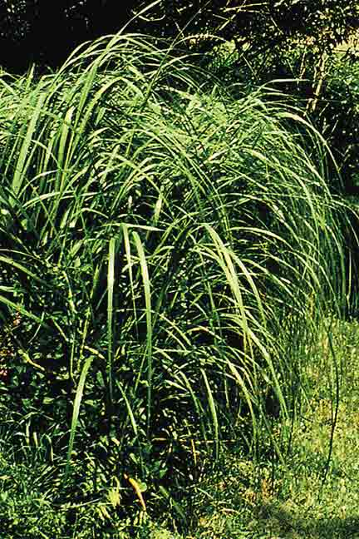
Grasses
Multiple species of Sedge, Rush and Spartina available.
Average height: 1-2m
Sedge (Carex acuta)
Rush (Juncus usitatus)
Cord grass (Spartina pectinata)

